Slide 1
ADF Pipeline Automation/Schedule
In this we are going to Schedule pipeline in ADF. But it is not mostly use in real time projects as Azure Logic apps has specially design for automation and has more features than ADF Automation and also pipeline run+ automation will increase the load on ADF for its smooth functioning

Slide 2
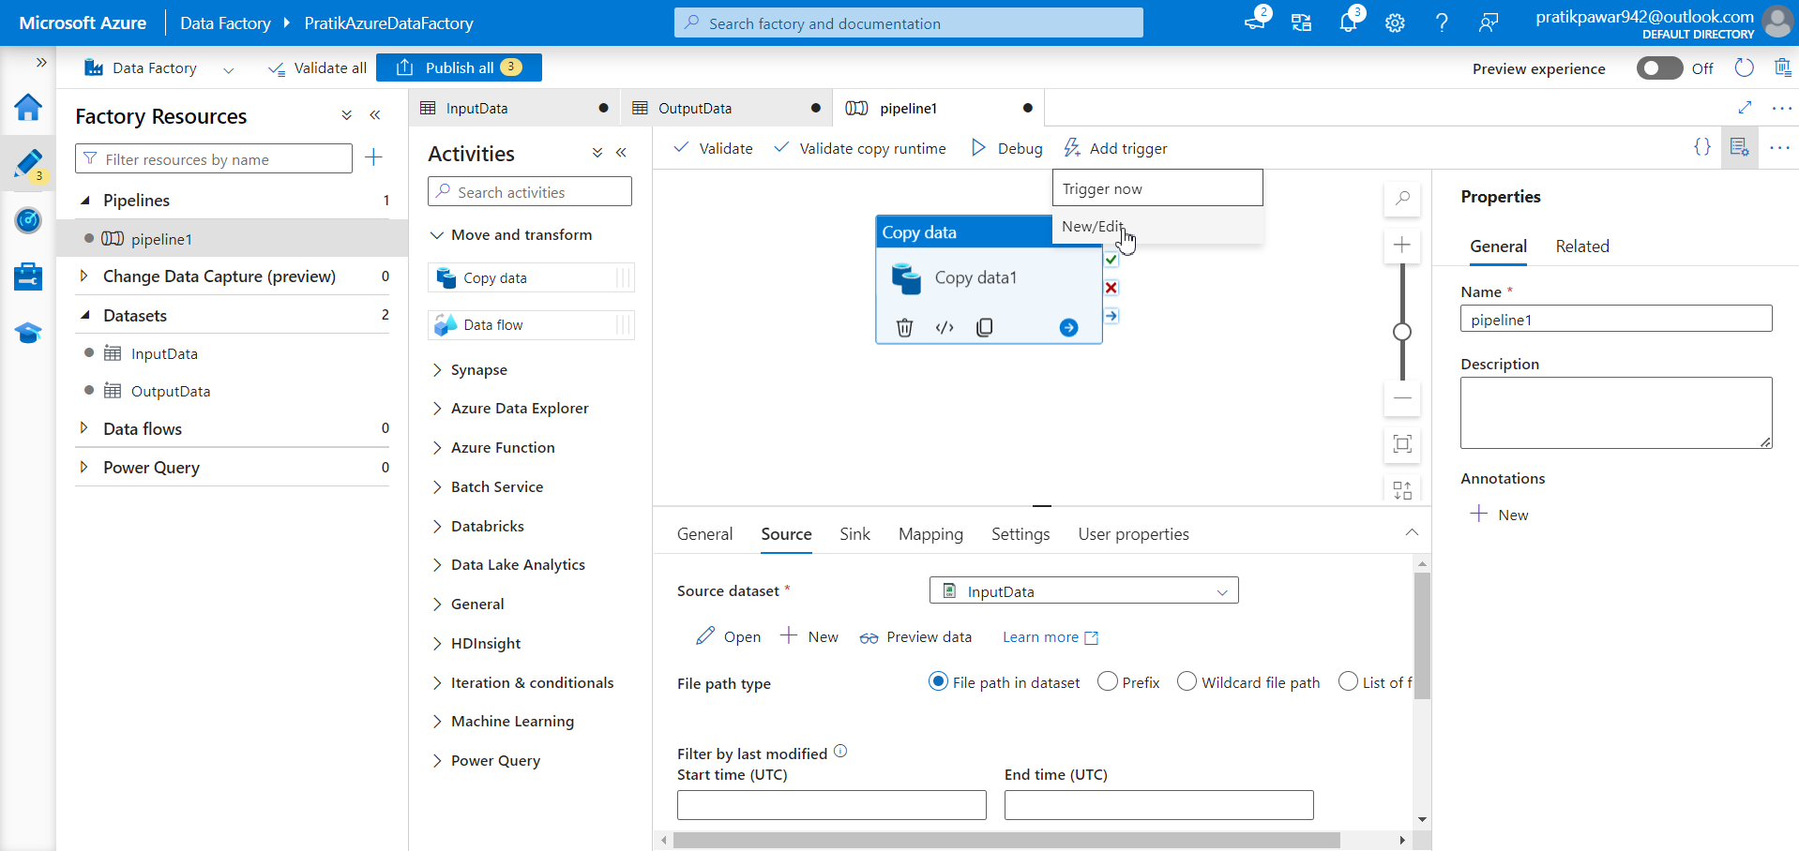
Go to Trigger Now > New/Edit

Slide 3
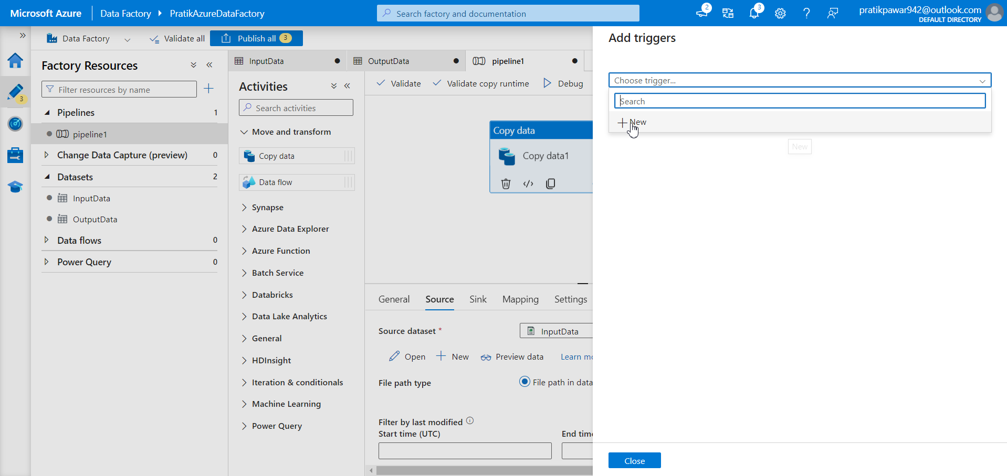
Go to Choose Trigger > New

Slide 4
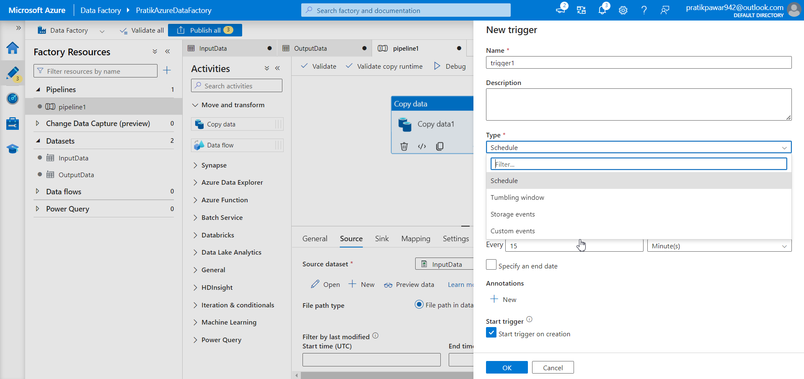
Click On Type

Slide 5
There are three types of Built-in triggers in ADF
Scheduled Trigger
Tumbling Window Trigger
Event based Trigger

Slide 6
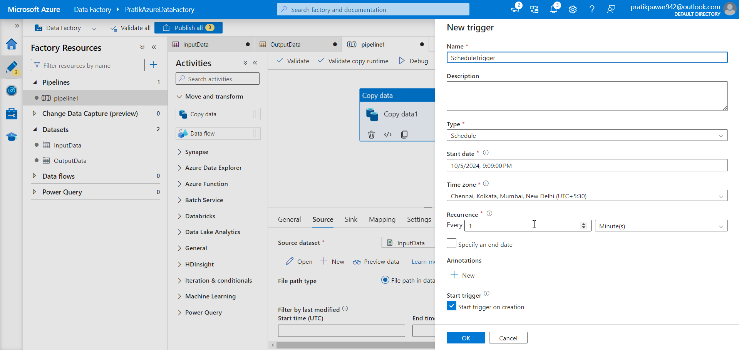
Now fill Schedule name , type , start date, timezone, Recurrence, etc and click ok

Slide 7
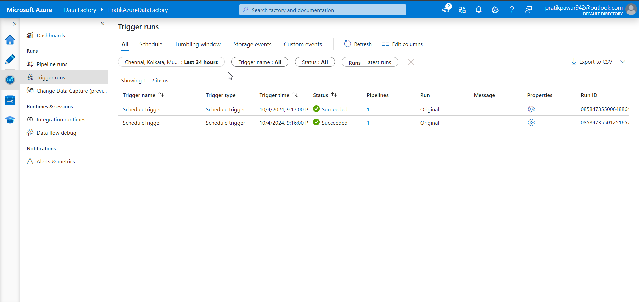
Pipelines are running automatically every minutes as schedule

Slide 8
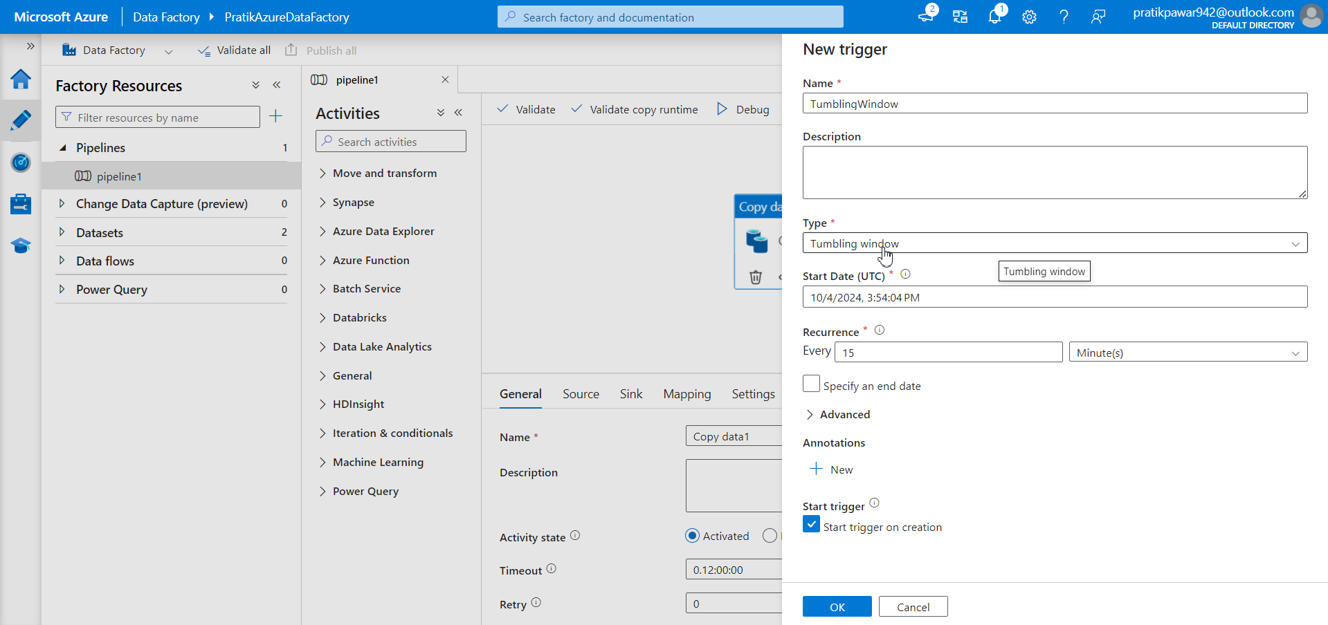
Now, Tumbling Window trigger

Slide 9
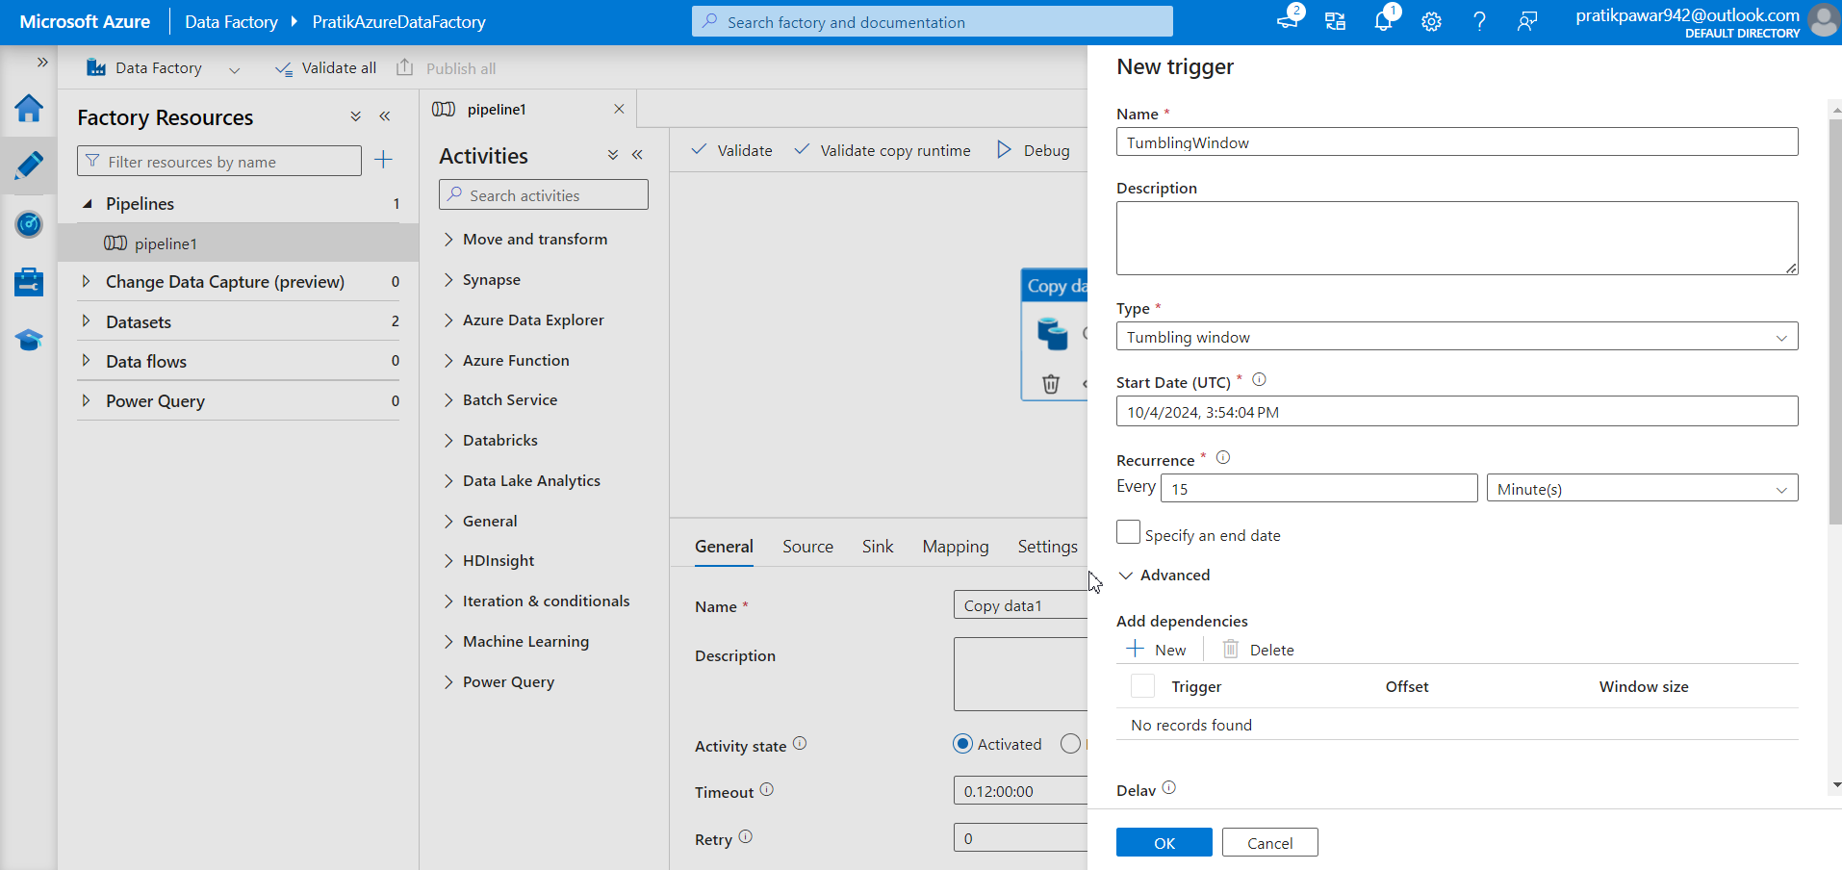
Tumbling window can trigger at past dates which schedule trigger can’t. Now who is better depends on use case

Slide 10
Important
Now if 4 pipelines are independent on each other, in schedule trigger and if 1 pipeline delays to run, schedule trigger does not bother and run 2 pipeline at schedule time inspite of dependacy so pipelines will not work properly.
But in tumbling window, we can set pipelines dependency on each other so 2 pipeline will only run after 1 pipeline and all pipelines will run properly

Slide 11
In Advanced > add dependencies we can set dependencies of 1 pipeline to other.

Slide 12
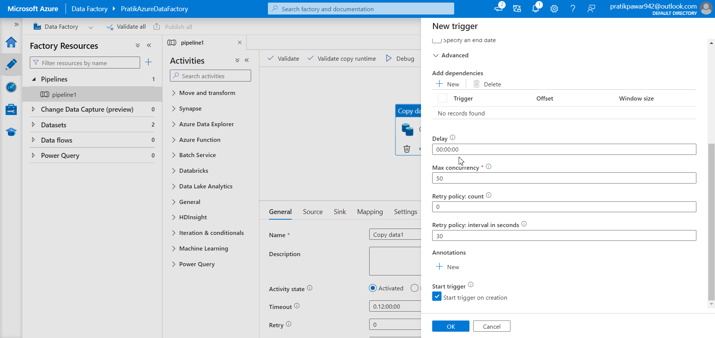
Also we can add delay so if first pipeline ran late so 2 one will wait for delay time which we have given to avoid proper running of all pipelines

Slide 13
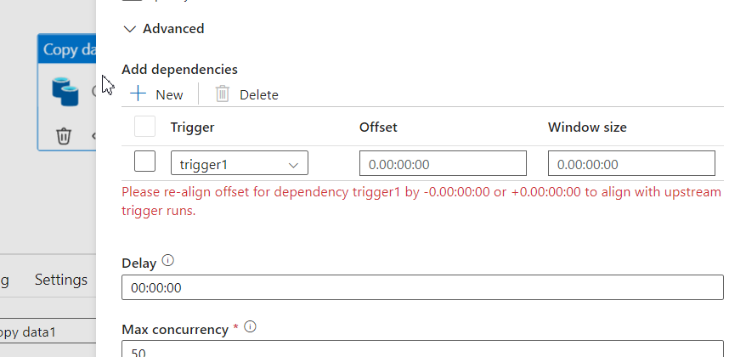
In this offset is start time and window size is like buffer of pipeline

Slide 14
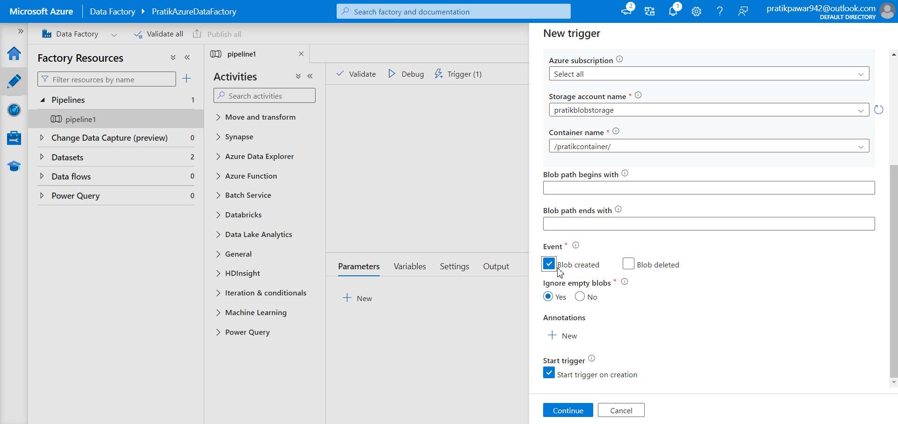
Now event Based trigger which triggers pipeline when Raw Data comes and not at any time like other triggers

Slide 15
Here fill info and go to events. Select blob Created. Blob means file. It means when new files comes in then run the pipeline or else don’t run the pipeline. So there is no unwanted runs of pipeline and wasting money. It runs only when event happens

Slide 16
Why we are not using inBuilt Triggers
ADF becomes Overload
It will do triggers but cannot give best because
Event based is specific to only one container where in Logic apps has lot of activities like when row is updated , when row is deleted, when blob(file) is added, created, updated, etc. it has n number of options.

